Slide 1
HousePrice prediction
By
Kapil Gupta

Slide 2
Goal
The goal is to predict House Sale Price.

Slide 3
Dataset statistics
Number of total variables 81
Number of observations 1460
Missing cells 6965
Missing cells (%) 5.9%
Duplicate rows 0
Duplicate rows (%) 0.0%

Slide 4
Data Pre-Processing using pandas pre profiling
*******Analysis on Misssing values as below**********
We can drop the ('Alley', 'PoolQC', 'Fence', 'MiscFeature', 'MiscVal', 'LowQualFinSF', 'EnclosedPorch', '3SsnPorch' , 'ScreenPorch', 'PoolArea', 'MiscVal' ) due to high more than 80% missing values
Uniform data, Maximum data is uniform or same more data more than 85%
'Id', 'Street', 'Utilities', 'LotConfig', 'LandSlope', 'Condition2', 'Condition1', 'BldgType', 'RoofMatl', 'Heating', 'CentralAir', 'Electrical', 'BsmtHalfBath', 'KitchenAbvGr', 'Functional', 'GarageQual', 'GarageCond', 'PavedDrive', 'SaleType', 'SaleCondition'

Slide 5
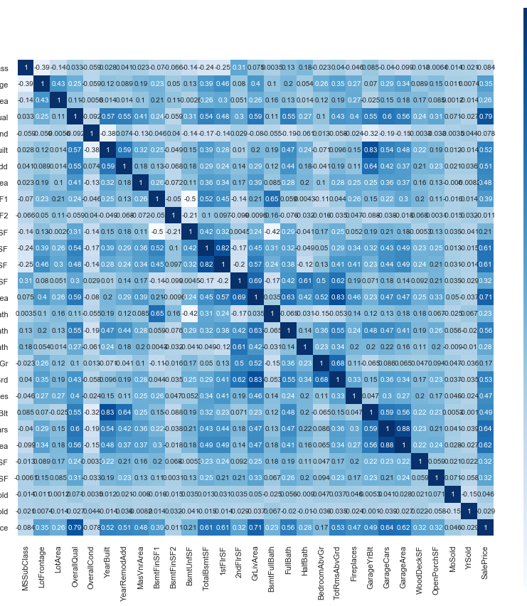
Missing Values Treatment
Observation form the Heat Correlation TV SalesPrice is highly corelated with OverallQuality, OverallCond, GrLivArea, YearBuil, YearRemoteAdd, TotalBsMTSF, GrLiveArea
YearBuilt is higly corelated with GarageYrBlt Hence we can drop one Drop,
1stflrSF is higly corelated TotalBsmtS, hence we can drop one ,
TotalRmsAbvGrd is higly corelated with GrLiveArea heance we can drop one
GarageCares is higly corelated with GarageArea , hence we can drop one
SalesPrice have very low/poor corelation with OverAllCond, MSSubClass, YrSold, BsmtFinSF2 and MoSiold can be drop them

Slide 6
Missing Values Treatment
Missing data as below
We have below Exp. Continuous Variable, Here we have apply iterative-imputer to replace the Null values
LotFrontage 1201 non-null float64
MasVnrArea 1452 non-null float64
BsmtFinSF1 1460 non-null int64
For Below Exp. Categorical varible, we use the MOD to replace the null values
MasVnrType 1452 non-null object
BsmtQual 1423 non-null object
BsmtCond 1423 non-null object
BsmtExposure 1422 non-null object
BsmtFinType1 1423 non-null object
BsmtFinType2 1422 non-null object
FireplaceQu 770 non-null object
GarageType 1379 non-null object
GarageFinish 1379 non-null object

Slide 7
Feature Engineering
We create new Exp. Variable premium_house
if house have more than 2 FullBath and more than 2 GarageCars

Slide 8
Checking Assumptions and post Data processing
Below is Normalization curve for TV Saleprice
Here we can see, curve is not normalize , Hence we took log of SalesPrice
After log of sales

Slide 9
Feature Selection
Before Feature selection we performed one Hot Encoding to handle Categorical data
We used SelectKBest and f_regression for feature Exteration
Top 11 Exp variable Feature score
Feature Score of OverallQual : 2436.7705909063657
Feature Score of GrLivArea : 1470.5850099552902
Feature Score of GarageCars : 1013.7056661608061
Feature Score of TotalBsmtSF : 880.3412823895806
Feature Score of ExterQual_TA : 774.677018963505
Feature Score of FullBath : 668.430296487314
Feature Score of YearBuilt : 548.6658210637419
Feature Score of KitchenQual_TA : 538.3585237788432
Feature Score of GarageFinish_Unf : 523.2464965022317
Feature Score of YearRemodAdd : 504.7148547249311
Feature Score of BsmtQual_TA : 482.24046384868586

Slide 10
Handling Outlier
We used Inter quartile range, 1.5 IRQ

Slide 11
Check Exp Variable linearity with TV

Slide 12
Scaling and Splitting X and y into training and test datasets
We used StandardScaler
Splitting X and y into training and test dataset with 80, 20

Slide 13
Applying ML Algo
We used Random-Forest and Liner Regression
RMSE Results of RandomForest
RMSE_train 0.1523
RMSE_test 0.5034
RMSE Results of LR
RMSE_train. 0.3869
RMSE_test. 0.4820
LR Model r_squared and adjusted_r_squared for Train and Test
r_squared Train. 0.8429
adjusted_r_squared Train 0.841
r_squared Test 0.8029
adjusted_r_squared for Test. 0.7947

Slide 14
Predict new result

Slide 15
Conclusion and Insights
Using random Forest for Regression gives poor results with very less RMSE values
Leaner Regression givens good results
* LR RMSE Train is .38 and RMSE Test is 0.48
RMSE Range goes from 0 to 1, it is not that small anymore. However, although the smaller the RMSE, the better model
* adjusted_r_squared for Test 0.79 and Train is .0.80
R-squared values range from 0 to 1 and are commonly stated as percentages from 0% to 100%.
An R-squared of 100% means that all movements of a security (or another dependent variable) are completely
explained by movements in the index (or the independent variable(s) you are interested in)
* Hence LR model is good for this Data set
However, We can increase the model performance by adding the more Exp. variable but their could be changes of
Overfitting

